Slide 1
Deep Learning
1/3

Slide 2
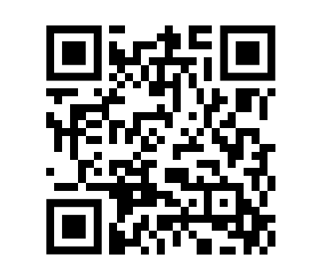
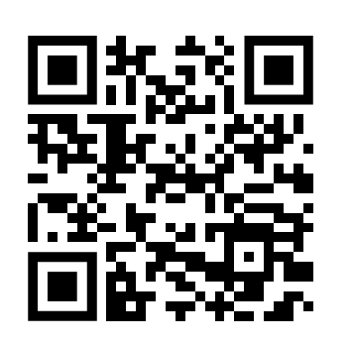
QR Code
Feedback
Quiz

Slide 3
Content
Tensor
Linear Regression Recap
Neural Network
Forward Pass
Backpropagation
Workflow

Slide 4
Tensor

Slide 5
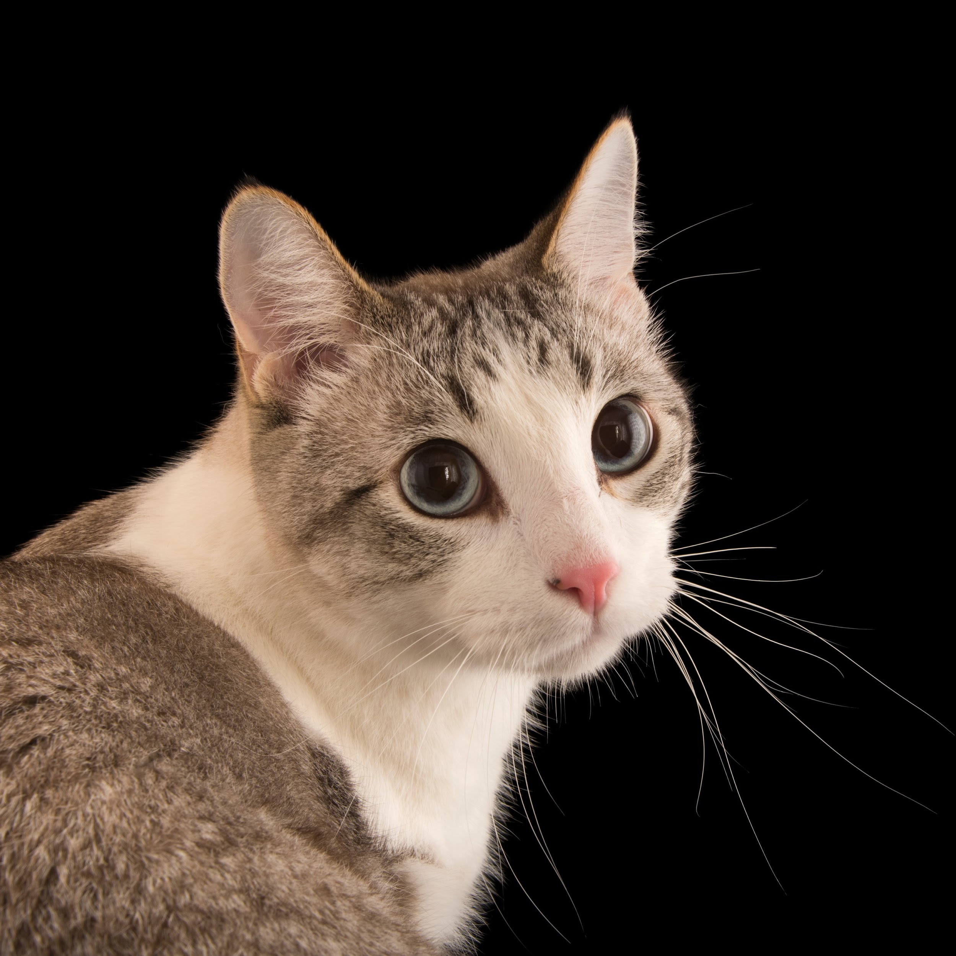
Flatten Image to Linear
Images are array of pixels, “unroll the array” to get linear
Let’s say this is a 3x3 image
Let’s say they are 1 pixel thick
You have 3 3x1 slices
Stacked into 9x1 vector/array/tensor

Slide 6
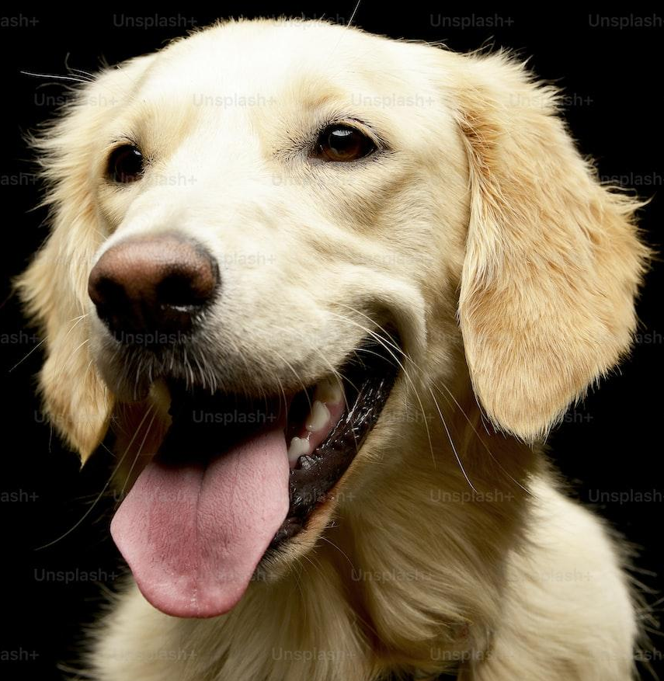

Slide 7
Q1: What do these visualization means

Slide 8
Q1: What do these visualization means

Slide 9
Q2: How does this affect

Slide 10
Q3: The model is trained. What is the same?
Flatten
the
image
Flatten
the
image

Slide 11
Q4: Is this allowed? What is the dimension of this?
Flatten
the
image
10 images
Linear(image_pixel_size, 5)
Linear(5, 4)
Linear(4,4)
Linear(4,1)

